Slide 1


Basics of Income and Income Tax
Notes:
Use this overview slide to introduce your presentation of this chapter.

Slide 2
Definition of income
Simply income means what comes in.
In a broader sense it connotes a periodical monetary return “Coming in” with some sort of regulatory or expected regulatory or definite sources.

Slide 3
Definition of Income as per I.T ordinance 1984: The term income means and includes the following :
Any income, profits or gains from whatever source is derived which are chargeable to tax under the heads specified in section 20. ( These are: Salaries, Interest on securities, Income from house property, Agricultural Income, Income from business or profession. Capital Gains, Income from other sources).
The Profits and Gains of any business of insurance carried on by a Mutual Insurance Association.

Slide 4
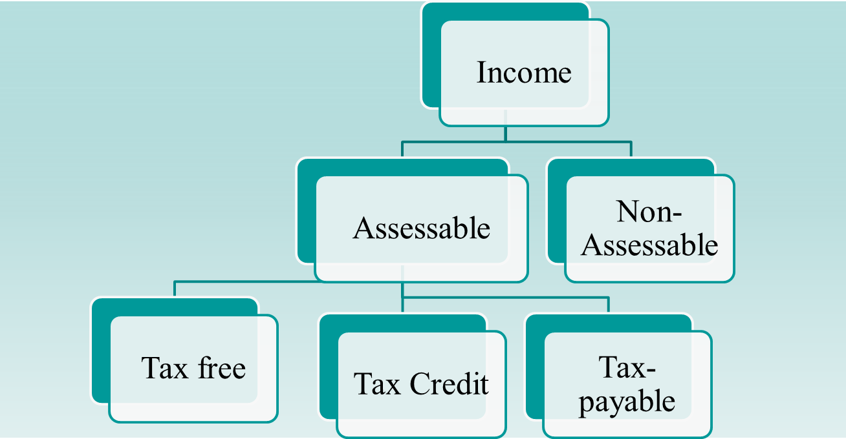
Classification of Income- on the basis of assessment

Slide 5
Assessable Income
Assessable Income/Taxable income: Those income which are included in the determination of the total income of an Assessee.
Tax Free income/ Average rate rebate income: Those income which are included in the determination of the total income of an Assessee but a tax rebate or relief is given on average rate of such income.
Example: 1) Income from partnership firm on which Tax already been paid 2) Income from association of person.
Average Tax rate = Total Tax ÷ Total income ×100

Slide 6
continue
Tax credit Income/ Investment Allowance/ Fixed rate rebate income: Those income which are included in the determination of the total income of an Assessee but Tax rebate is allowed of an amount equal to 15% of sum eligible for Tax rebate.
Amount of allowable investment is - actual investment or 30% of total income or Tk. 150,00,000/- whichever is less. Tax rebate amounts to 15% of allowable investment.

Slide 7
Tax payable income:
This is the amount ultimately for which assessee pays the Tax.
Tax payable income= total income - Tax credit income – Tax free income.

Slide 8
List of Non-assessable Income
Income from House property or operation of Religious and Charitable Trust
Voluntary contributions received by The Religious or Charitable Institution
Income of Micro credit operation of NGOs
Income of Local Authorities
Income of Specific Funds: Income of a provident fund in the Provident Fund Act, 1925 applies and Income of Workers Participation Fund under the Companies Profits (Workers Participation) Act, 1968 subject to any such conditions and limits as may be prescribed.
Special Allowances: If it is granted to meet expenses wholly for office duty, or, If it is incurred necessarily in the performance of the duty or duties of an office or employment of profit
Income received by The Trustees of Recognized Provident Fund

Slide 9
Cont.
6. Income of Employees of Foreign Missions
7. Pension:
8. Dividend: up to 25000.
9. Interest on Government Securities
10. Interest on Tax –free securities is fully non-assessable.
11. Gratuity
12. Income from export business

Slide 10
Rest are on Reference book Page 128-1320.

Slide 11
Definition of Income Tax
“Income Tax is a tax on income”—Peter merchant Ltd vs Stedeford.
“Income Tax for any assessment year at any rate or rate shall be charged, Levied, paid and collected in respect of total income of the income year or income year of every person”------ITO 1984.
Notes:
Use the slide to support the value of the course.

Slide 12
Characteristics of income Tax
It is a direct Tax
The levy of the Tax is regulated by the ordinance, 1984.
It is charged on the total income of an income year of a person in an assessment year.
The rate of the tax is determine by the govt. in the national assembly through Finance Act.

Slide 13
Income Year
According to section 2(35), income year means the financial year (i.e. the year commencing on one July every year) immediately preceding the assessment year or any other accounting period (Not exceeding 12 months) as adopted by the assessee and ending within the said financial year.

Slide 14
Assessment Year
According to section 2(9), Assessment year means the period of 12 months commencing on the first day of July every year. It is the year in which the assessments are made for taxation purpose of total income earned during the relevant income years by the assesses.
It is the next year of Income year.

Slide 15
Example of the year
Income year | Assessment year
2010-2011 2012-2013 2013-2014 | 2011-2012 2013-2014 2014-2015

Slide 16
Assesses
According to section 2(7), Assessee means a person by whom any tax or other sum of money is pay able under the ordinance and includes :
Person against whom income tax case / proceedings is going on
Person who is required to file income tax return
Person who desires to be assessed and submits income tax return.
Person who is deemed to be an assessee or, an assessee in default under any provision of income tax ordinance.

Slide 17
Classification of Assessee
Assessee can be classified into Two Type:
On the basis of Person
On the basis of residential status

Slide 18
Classification on Person
The ordinance has provided an inclusive definition of the term person. according to section 2(46), person includes the following :
An individual
A firm
An association of persons(AOP).
A Hindu undivided family (HUF)
A local authority
A company and
Every other artificial judicial person.

Slide 19
Classification on Residential status
Resident:
An individual will be a resident in any income year if he fulfills any of the condition stated in the section 2(55) of the ITO. Such as , he should Stay for a period of 182 days or more in the year.
Non resident: ( Two type)
If any one can not full fill the condition of the section 2(55) of the ITO.
1.Non resident Bangladesh 2. Non resident Foreigner

Slide 20
Effect of Residential status in determining tax liability
To determine the amount of total income:
A resident consider global income as his total income but a non resident does not consider income from other country in his total income
2. To determine minimum limit of Taxable income:
- Resident Assessee gets a benefit of minimum limit of total income upon which no tax should be given but non resident Assessee does not get this facility.

Slide 21
continues
3. Tax Rate:
For resident or non resident Bangladeshi, tax is calculated at various rate at various level of income. Like 0% on first, 220000, 10% on next, 300000, 15% Next 400000, 20% on next 500000, 25% on next 3000000 and 30% on remaining balance. But For non resident foreigner has to pay tax at maximum rate i.e. 30%.
4. Tax rebate: No tax rebate is given to Non resident.
5. Tax liability:

Slide 22
Income Tax Authority
Level | Administrative | Judicial
Top | National board of Revenue | Appellate Tribunal
Middle | Chief commissioner of Tax Director general Inspector of Tax ( Tax payer Unit) Commissioner of Tax ( Training) Director general ( central Intelligence cell) Commissioner of Tax | Commissioner of Tax ( appeal) Appellate Additional Commissioner of Tax Appellate Joint commissioner of Tax
Bottom | Deputy commissioner of Tax Tax Recovery officer Assist. Commissioner of Tax Inspector of Tax

